Slide 1
release!
2017 May 3
Notes:
We are excited to finally be able to officially release the long awaited BestEV system, a collaborative effort to spur NEV demand and high-performance supply of EVs in China. We thank the 28 experts who assisted in the design of the ranking system in 2015-16, Energy Foundation China for its instrumental kick-off support, and our dear coalition members who have joined the commitment to make China’s first crowed-based ranking a strong force for electric mobility commercialization.

Slide 2
The Drive for NEVs
Carbon Mitigation
at Electricity generation points is easier than at user point
Improved Urban Air Quality
via reduced tailpipe emissions
Global Leadership
of China’s Auto Industry via emerging NEV market
5 million by 2020
Notes:
Why so many policies are emerging in support of NEVs? What drives the 5m goal for 2020? There seem to be three main forces [read from the figures, bottom-up].

Slide 3
NEVs In numbers
65% Annual Growth
Global leader since 2015
$7.2 billion Govt’ Invest’
507k NEVs in 2016
65% of global NEV sales
263 NEV Models
(213 domestic)
Notes:
NEV produced (and sold) 507k in 2016, China has positioned itself as global leader already in 2015: 65% market growth from last year by production volume, spurred by $7.2 billion govt investment. Demand and supply are still highly “pushed” by multiple policies such as subsidies and soon – NEV credits trading.

Slide 4
problem
NEV production is high but most sales are not by private users
Battery is expensive, compensated by downgrade of vehicle performance
Consumer lack knowledge and guidance for make confident purchase choice
Current EV reviews and rankings are NOT transparent and NOT scientifically structured
Notes:
However, key problems remain and threaten to underpin the sound commercialization of NEVs: [read off the slide]

Slide 5
Purpose
Collect information from consumers
Understand consumers
Analyze &Rank NEVs
Guide improved NEV supply
Improve Ranking Criteria
Notes:
BestEV design to face some of these challenges. By constructively collection information from consumers, demand requirements could be better understood. This information is useful bot only for potential NEV buyers, but also to produces. This is why the data will be analyzed and used for annual ranking and periodic NEV reviews. We project these outputs will impact manufacturers and guide improved NEV supply. These improvement will also be traced and will enable constant upgrading of the system, to ensure it is technologically up to date.

Slide 6
process
Reliable Real-World NEV Big-Data Platform
Crowed Ranks
Experts set criteria
Notes:
The process behind the BestEV is rather simple: 1st experts set criteria and adjust annually according to technological market improvements, then NEV owners and test-riders fill-in the criteria (more questions and more weight is given to owners of course), than a reliable real-world NEV performance data platform is created and instantly shows personal final ranking and cumulative ranking of every NEV available on the market.

Slide 7
system
App
Website
Activities
Dataset
Notes:
BestEV Consumer-facing System is therefore comprised of four key elements: (1) a WeChat-based App for data collection and results viewing, (2) Website that fills similar purpose from a desk-top/tablet, (3) Data-base that hold the constantly increasing row data, and (4) Activates designed to market BestEV and expand its outreach to as many people possible.

Slide 8
system
App
Website
Activities
Dataset
Notes:
Lets first look at the App, the heart of BestEV.

Slide 9
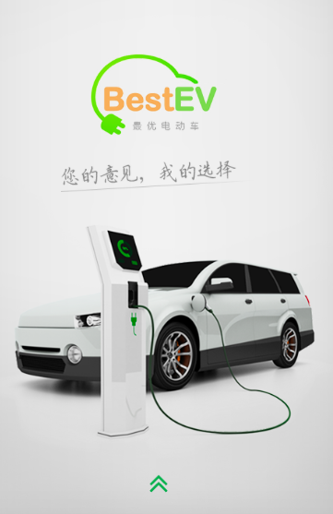
http://www.bestev.org/phone/
Notes:
Lets browse through the BestEV App main features…

Slide 10
system
App
Website
Activities
Dataset
Notes:
The BestEV website showcases the features of the App and more.

Slide 11
http://www.bestev.org
Notes:
Lets take a quick tour into the BestEV website…

Slide 12
system
App
Website
Activities
Dataset
Notes:
At the back of the App and website is the ever-increasing data-base of real-world user inputs.

Slide 13
Data-Base
NEV Actual Performance Data-Base
→ Annual Ranking
→ By-Topic, Periodic Analyses
→ Trends Analysis
Notes:
As data generated by users of the App and website is accumulated, three main outputs are created and managed: (1) annual ranking is released for best and least performing NEVs, (2) Periodic by-topic analyses of NEVs, manufacturers and consumer sensitivities, (3) Trends analysis to track changes of time.

Slide 14
system
App
Website
Activities
Dataset
Notes:
Last, are the activities of the BestEV which are designed to increase the general public’s exposure to the BestEV.

Slide 15
Activities
Engagement & expansion
WeChat Posts
Video channel
Marketing & presentations
Events
Notes:
Activities include: ….

Slide 16
system
App
Website
Activities
Dataset
Notes:
To sum up, the BestEV is a crowed-ranking system for NEVs and as such it is comprised of two consumer facing applications (WeChat App and Website), analysis driven outputs, and engagement activities.

Slide 17
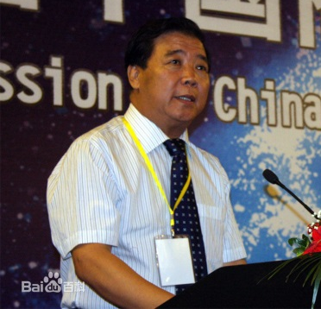
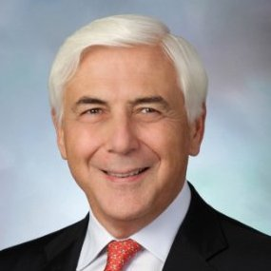
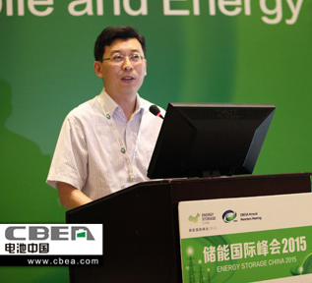
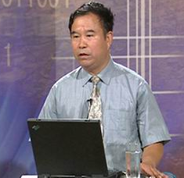
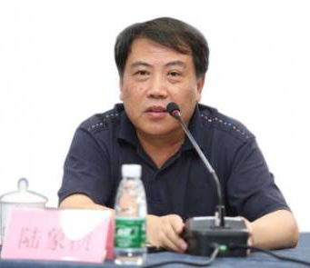
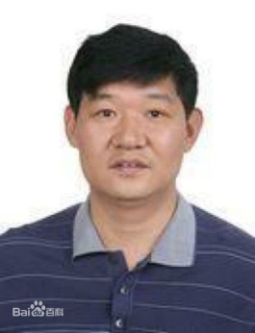
Thanks, experts!
付于武先生，
中国汽车工程学会
理事长
Cuneyt Oge 先生
国际汽车工程学会
理事长
张永伟博士
中国电动汽车百
人会秘书长
陈全世先生
清华大学汽车研究所所长
王成先生
中国汽车技术
研究中心, 北京
副主任
许心超先生
北京市科委新能
源处处长, 新能源汽车
推广主管领导
陆象桢先生
深圳市发改委重
大办主任, 新能源汽车
推广主管领导
王贺武先生
清华大学汽车
系副教授
And twenty more experts…
Notes:
We once again wish to thank the following eight distinguished experts for their support in the development of the BestEV ranking criteria, and all the other experts that have contributed much of their time for this non-profit initative.

Slide 18
Join Us!
www.bestev.org
BestEV是一个基于联盟伙伴的合作倡议
期待更多伙伴加入！
Notes:
Welcome to join our effort, we are currently nine strong coalition members, have both Energy Foundation China and UNEP backing, and we are seeking to create disruptive impact for driving the sound commercialization of quality NEV! 我们也欢迎更多伙伴加入BestEV合作联盟，目前这个联盟有9位成员，在大家的共同努力和见证下，我们的工作将对电动汽车的商业化发展产生重要的影响！

